Slide 1
Software Evolution (Reset)
Michael English

Slide 2
Module Assessments
Assessment 1: Presentation 1 (Week 7): 10%
Assessment 2: Presentation 2 (week 11 and 12): 20%
Assessment 3: Research Report/Paper (Due 23rd December 2024 17:00): 70%
Repeat Assessment (summer): 70%
You cannot submit an assessment that you (or someone else) has previously submitted to this or another module in UL or elsewhere or that has similarity to such an assessment.
For all assessments, you are required to declare your use of GenAI tools or other such tools that you have used in the preparation of an assessment.

Slide 3
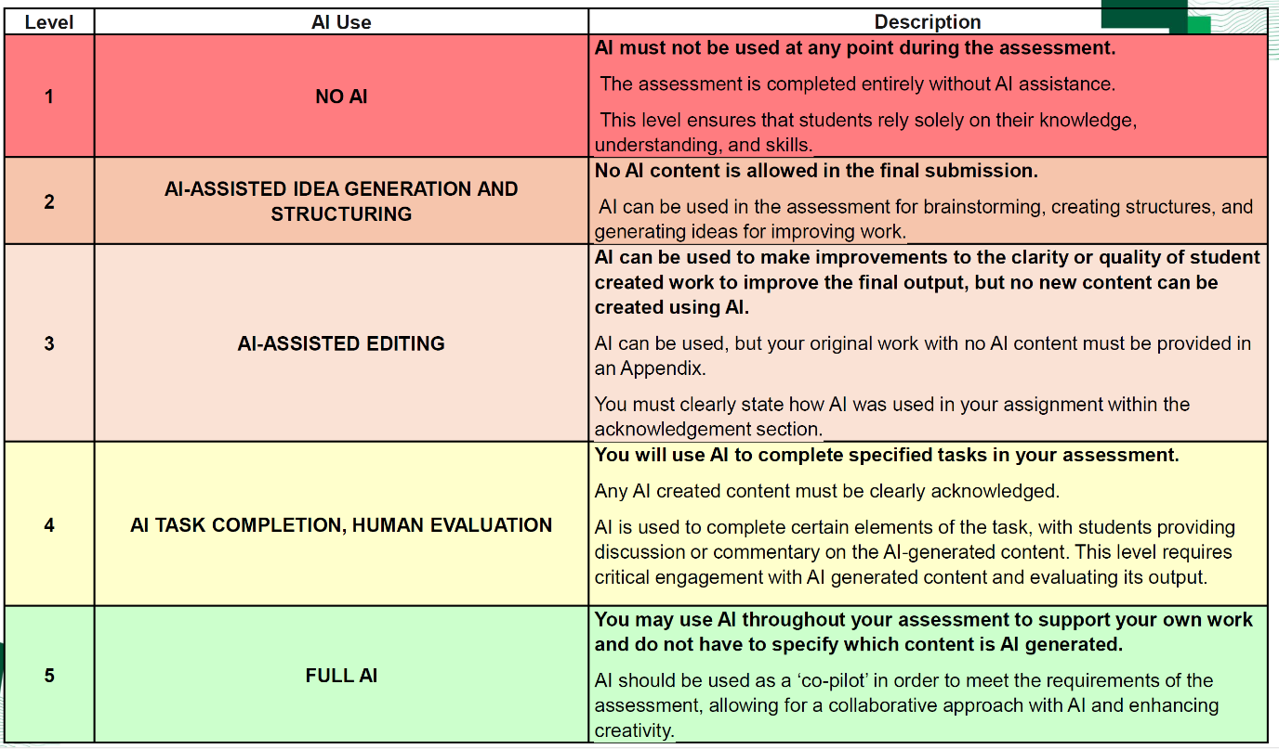
Declaration of use of GenAI
Insert (a) table(s) like the one below with each assessment
e.g. after the title slide in a presentation, or after the title page in a report.
Figure 1: Levels of AI/Gen AI usage (O'Sullivan et al.)
Tool
Assessed Usage Level
Describe Precise usage

Slide 4
Grading Scheme
30% D2
35% D1
40% C3
48% C2
52% C1
56% B3
60% B2
64% B1
72% A2
80% A1
See handbook of Academic Regulations (A1/A2 represent outstanding/exceptional performance)

Slide 5
Module Assessments
For all three assessments:
Theme for each assessment must be linked to software evolution.
Individual assessments (not team based)
Slides/paper to be submitted to Brightspace. The deadline for submission will be on the Brightspace assignment. For presentations the deadline will be in advance of first presentation schedule.
Failure to submit on time results in penalties/0 marks being awarded.
For exceptional circumstances (e.g. illness documented with certification) alternative arrangements will be discussed on an individual basis (for assessment 1 and 2).
For exceptional circumstances in relation to assessment 3 where a student cannot submit this assessment on time the student should consider applying for an I-grade.
In other cases, where assessment 3 is not submitted on time, an F-grade will be awarded and thus the module will need to be repeated over the summer and in time for the annual repeats.

Slide 6
Module Assessment 1
Presentations Week 7: (10%)
Individual presentation
5 minutes in person (time limit will be strictly adhered to)
Due date for slides: Wednesday week 8 12h00.
outside normal class times Thursday/Friday week 7 (timeslots to be selected from shared spreadsheet)
Focus on “classic” paper
One that has been shown to be very important in the field (e.g. gets referenced a lot)
Introduced a new concept/method/paradigm that was adopted
Summarises and synthesises existing research and is central to the field.

Slide 7
Module Assessment 2
Presentations Week 11/12: (10%)
Individual presentation: Exact dates to be confirmed
Due date for slides: Wednesday week 11, 12h00.
7 minutes in person (time limit will be strictly adhered to)
outside normal class times (timeslots to be selected from spreadsheet which will be shared)
Focus on 5 core research papers related to the topic for your final research paper. Focus on the current state of the research.
To avoid multiple submissions on the same topic, topic proposals will have to be approved (shared spreadsheet will be provided.

Slide 8
Module Assessment 3
Individual Assessment
Report on a research topic (70%)
Due 23rd December 2024 17:00
Must build on Assessment 2
Word Limit: 4000 words
Remember the quote: “ I have made this longer than usual because I have not had time to make it shorter” (Blaise Pascal?)
Aim to make your paper shorter. Be structured, focused, succinct and precise in your writing.
Minimum 10-15 citations (papers you have read). The quality of these papers is also important. i.e. Peer reviewed from high quality journals/conferences.

Slide 9
References
I. O’Sullivan, A. Risquez, M.C. Kennedy and F. McGrath, “Academic Integrity and Assessment” Presentation from Centre for Transformative Learning and Academic Integrity Unit, University of Limerick.

Slide 10
Discussion
To take place in class….

Slide 11
Thank you

